Slide 1
CMPE 202
AKATSUKI
CS Unplugged Team Project

Slide 2

Team
Ajay Tanpure
Darshan Sapaliga
Mayank Tanwar
Nachiket Joshi
Niranjan Tungatkar

Slide 3

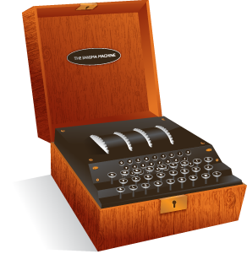

Cipher Wars
What it is?
Decode the cipher
Save your city!

Slide 4
Design Pattern Implimentation
Factory Pattern
For creating maps
For Creating Cipher Object
For Creating Enemy Object
State Pattern: For maintaining state(new game, game over etc) of game
Strategy Pattern: For Attacking Cities
Class Diagram

Slide 5
Highlights Of The Game
Multiplayer scope with restlet implementation.
Use of Algorithms to encrypt and decrypt.
Object Oriented Approach.
Can easily be extended with more algorithms.

Slide 6
LINKS
Github repository : https://goo.gl/PyVoe4
Team's Task Board : https://goo.gl/6AdTxt
Teams Burndown Google Sheet : https://goo.gl/8PCxDI
Kanban CFD Google Sheet : https://goo.gl/9jpWl0

